Slide 1
Feature Scattering in the Large: A Longitudinal Study of Linux Kernel Device Drivers
Leonardo Passos lpassos@gsd.uwaterloo.ca University of Waterloo
Canada
Jesús Padilla jpadillagaeta@gsd.uwaterloo.ca University of Waterloo
Canada
Thorsten Berger jpadillagaeta@gsd.uwaterloo.ca University of Waterloo
Canada
Sven Apel apel@uni-passau.de University of Passau
Germany
Krzysztof Czarnecki kczarnec@gsd.uwaterloo.ca University of Waterloo
Canada
Marco Tulio Valente mtov@dcc.ufmg.br Federal University of Minas Gerais Brazil
Modularity’15 Research Track

Slide 2
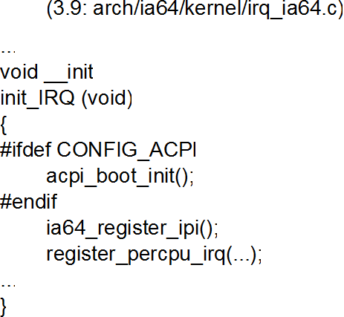
Feature CONFIG_ACPI is scattered across the IA-64 CPU code
Feature = configuration option

Slide 3
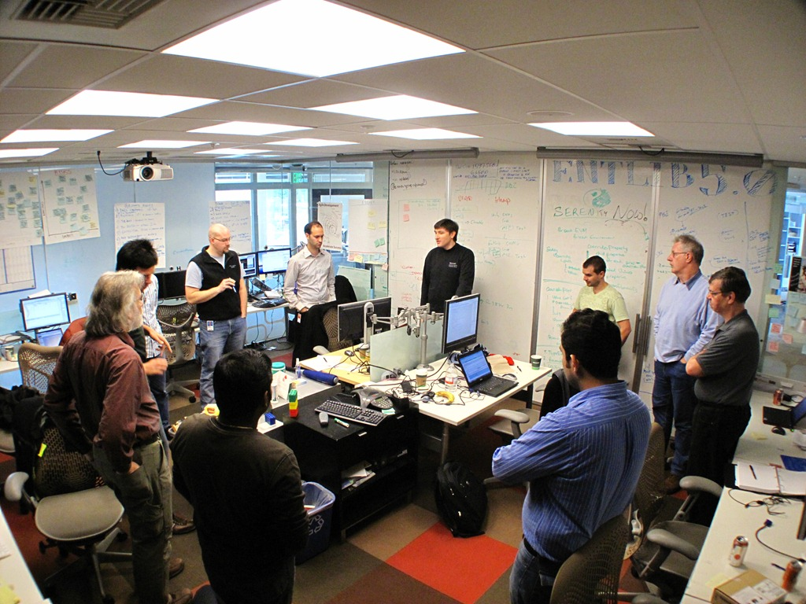
Hinders parallel development

Slide 5
Leads to code tangling, negatively affecting code understanding

Slide 6
Nonetheless, feature scattering is a popular mechanism to support new features

Slide 7
Quick solution understood by all developers

Slide 8
No modules, no interfaces, no design patterns, etc.

Slide 9
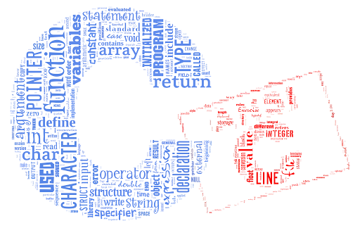
Allows overcoming modularity limitations in existing
programming languages
(not every feature can be modular)

Slide 10
axTLS
FreeBSD
Coreboot
SeaBIOS
Many large & long-lived software systems have shown that is possible to continuously-evolve in the face of feature scattering

Slide 11
However, no empirical study has investigated feature scattering in the evolution of large and long-lived systems

Slide 12
Such kind of studies are key in creating a general theory on how to effectively manage feature scattering
Notes:
Thus, we argue…

Slide 13
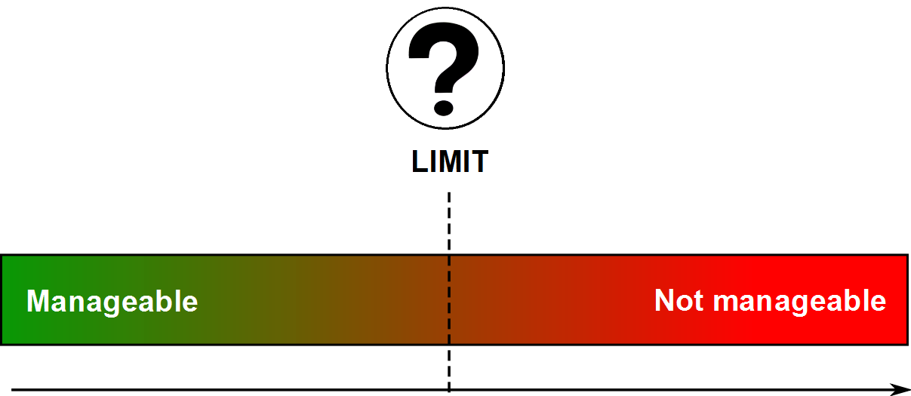
How could a theory help?
Scattering is not necessarily bad (easy & cheap solution)
Scattering is harmful
Scattering

Slide 14
Many empirical works have to be performed before devising such a theory

Slide 15
“A journey of a thousand miles must begin with the first step”

Slide 16
Starting point: the Linux kernel

Slide 17
> 13,000 features
feature-oriented system
continuously evolving

Slide 18
r = 0.996

Slide 19
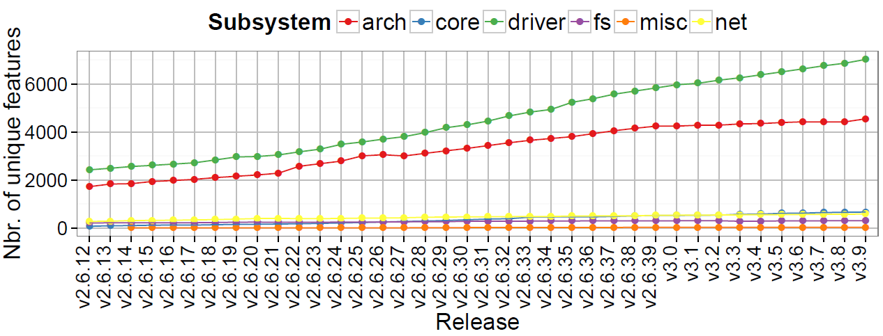
Scope: device-driver features

Slide 20
In our analyses, we consider scattering of features in terms of referring ifdefs

Slide 21
Scattering degree (SD)
of a feature f
Nbr. of ifdefs
referring to f

Slide 22
ifdefs
#ifdef, #ifndef, #elif, #if

Slide 23
A feature f is scattered if its SD(f) ≥ 2
#ifdef CONFIG_ACPI || CONFIG_PM
#if defined(CONFIG_ACPI)
#ifndef CONFIG_ACPI
...

Slide 24
From the kernel evolution history, some limits clearly emerge...

Slide 25
% of scattered features is nearly constant
(~ 18%)

Slide 26
Local vs global scattering

Slide 27
A feature is locally scattered when its referring ifdefs are restricted to files in the
driver subsystem only

Slide 28
A feature is globally scattered when there is at least one referring ifdef in a file outside the driver subsystem

Slide 29
Stabilization (~ 43%)
% of globally scattered features is increasing,
but ≤ 43% at all times

Slide 30
What about the scattering degree of features?

Slide 31
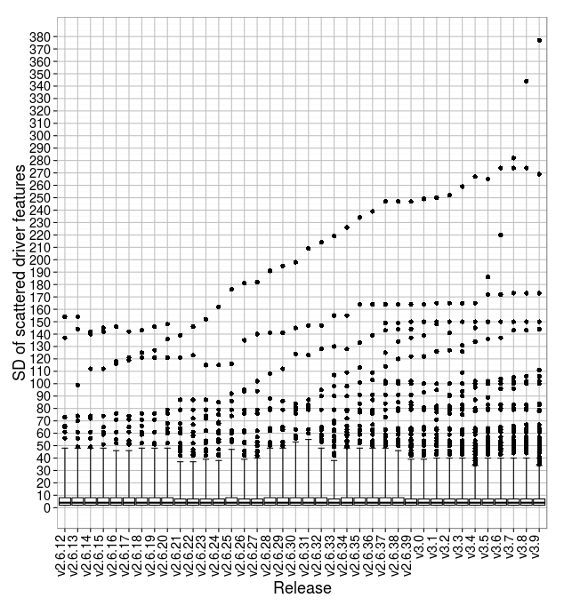

Slide 32
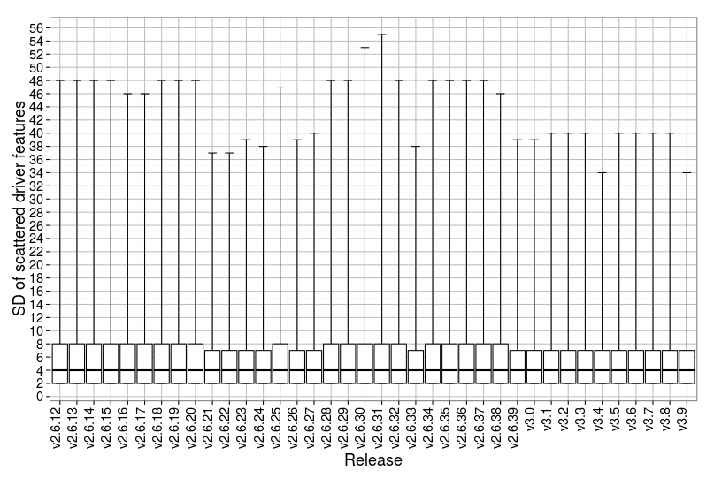
For 50% (median) of scattered-driver
features, SD ≤ 4

Slide 33
For 75%, SD ≤ 8

Slide 34
Non-outlier features: 8 < SD ≤ 55

Slide 35
Outliers: 35 ≤ SD ≤ 377

Slide 36
There appears to exist different groups in Linux, with different SD-limits

Slide 37
Group 1 (low SD): SD ≤ 4
50% of scattered-driver features

Slide 38
Group 2 (medium SD): 5 ≤ SD ≤ 8
25% of scattered-driver features

Slide 39
Group 3 (high SD): SD > 8
Non-outliers: ~ 22.5% Outliers: ~ 2.5% (max SD = 377)

Slide 40
… a single SD-limit controlling all features does not seem to apply

Slide 41
In summary, …

Slide 42
% of scattered-driver features ~ 18%
% of globally scattered-driver features ≤ 43%
SD is not defined by a single absolute value, although most features (75%) have SD ≤ 8

Slide 43
75% of scattered-driver features have SD ≤ 8
no more than 25% of features have SD > 8 (relative limit)

Slide 44
What about possible factors influencing the observed scattering?

Slide 45
Platform-driver features: features whose drivers support devices that cannot be discovered by the CPU
Infrastructure-driver features: abstractions in the O.S domain (e.g., ACPI)

Slide 46
The analyses of a random-sample
shows statistically significant results :
Platform-driver features are 2.5x more likely to being globally scattered than non-platform ones

Slide 47
In the sample, global scattering of platform-driver features occurs mostly in the arch subsystem
Tight relationship between platform-driver features and CPU-dependent code (hard to modularize)

Slide 48
In general, there is no relationship between infrastructure-driver features and global-/local-scattering

Slide 49
In general, there is no relationship between being a platform-driver or infrastructure feature in scattering degree

Slide 50
There is, however, a relationship between extreme scattering and infrastructure-related driver features

Slide 51
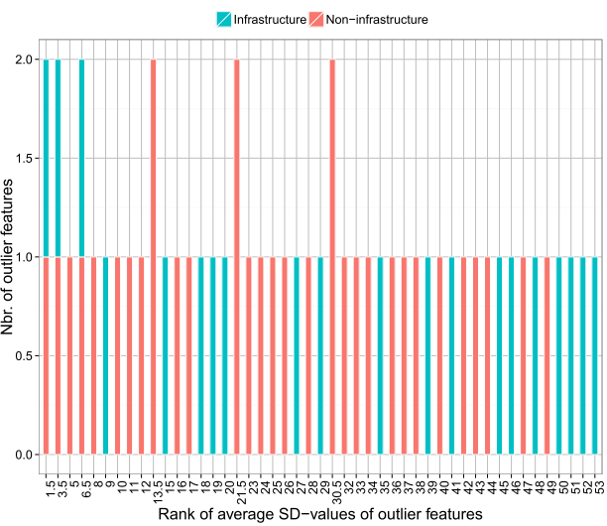
extreme scattering
9/15 are infrastructure

Slide 52
Wrapping up…

Slide 53
In the Linux kernel
Most driver features are not scattered (~ 82%)
C-language modularity constructs + the kernel plugin-based architecture are “good enough”

Slide 54
In the Linux kernel
When the existing solutions are not good enough, developers scatter features in code

Slide 55
In the Linux kernel
Scattering seems to respect some limits (consciously enforced???)

Slide 56
Next steps

Slide 57
Conduct interviews
Are the observed limits consciously enforced in practice?
If so, how, and how were they set-up?

Slide 58
If not, why do they occur?
Do they indirectly stem from some development practice or process?

Slide 59
Investigate whether the limits we found also apply to other systems (ongoing collaborative work)

Slide 60
Thanks for listening :)
http://lpassos.bitbucket.org/modularity15/

