Slide 1
MathCheck: A Math Assistant Combining SAT with Computer Algebra Systems
Ed Zulkoski, Vijay Ganesh, Krzysztof Czarnecki
University of Waterloo
August 7, 2015

Slide 2
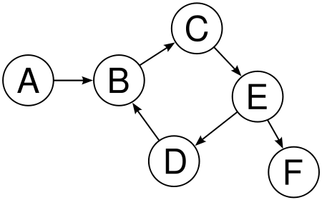
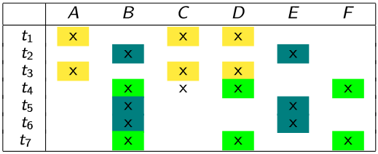
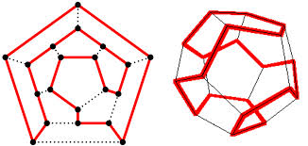
Many problems have an underlying Boolean structure, but are not easily expressed using standard SAT/SMT solvers.
Problem Statement
Acyclicity (Gebser’14)
Constrained Clustering (Métivier’12)
Hamiltonicity (Velev’09)
Finite domain search + complex predicates.

Slide 3
Goals
Computer algebra systems (CAS) contain SOTA algorithms for solving complex properties
SAT solvers are one of the best general approaches for finite domain search
Goal 1: incorporate algorithms from a CAS with a SAT solver for:
Counterexample Construction for Math Conjectures
Bug Finding
Goal 2: design an easily extensible language/API for such a system
Current focus is on graph theory

Slide 4
DPLL(CAS) Architecture
Extensibility preferred to a “one-algorithm-fits-all” approach.

Slide 5
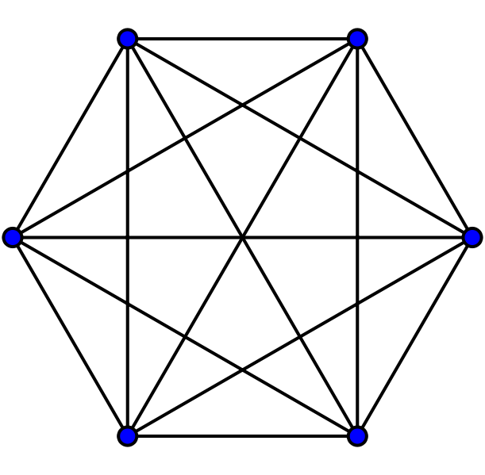
Graph Variable Representation
graph x(6)
One Boolean per each potential vertex
One Boolean per each potential edge
Mapping between graph components and Booleans to facilitate defining SAT-based graph constraints

Slide 6
Case Study: Ruskey-Savage Conjecture
Conjecture: For every $d≥2$, any matching of the hypercube $Q_{d}$
extends to a Hamiltonian cycle.
Matching – independent set of edges that share no vertices
Maximal – cannot add edges without violating the matching property
Perfect – it covers all vertices
Hamiltonian cycle – cycle that touches every vertex
Previously shown true for $d≤4$
$$Q_{3}$$

Slide 7
Case Study Specification ($d=5$)
graph x(32)
sage.CubeGraph G(5)
//$∀x. matching\left(x,G\right)⇒extends_to_hamiltonian(x,G)$
assert( matching(x,G) $∧$
imperfect_matching(x,G)$∧$
maximal_matching(x,G)$),$
query( extends_to_Hamiltonian_cycle(x,G))
Unsat
matching(x,G)
~10 LOC
Blasted to SAT
~5 LOC
imperfect_matching(x,G)
~5 LOC
maximal_matching(x,G)
~25 LOC
Checked with SAGE
extends_to_Hamiltonian_cycle(x,G)
Notes:
CONVERT TO ASSERT-QUERY
, sufficient conditions, hand proofs.
extends is ~30 loc when preventing isomorphic HCs

Slide 8
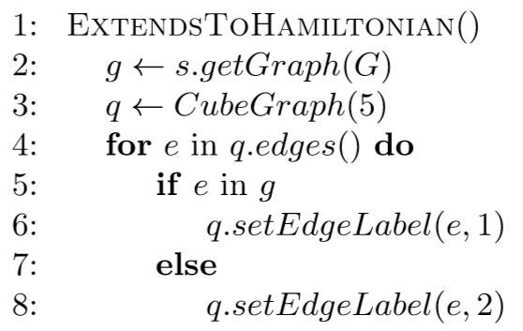
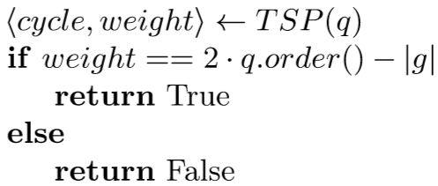
2
2
2
1
1
2
2
2
2
2
1
8

Slide 9
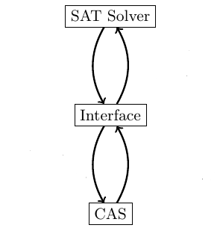
Case Study Approach
Unsat after ~8 hours on laptop (Conjecture holds for $d=5$)
For a pure SAT encoding, we need encode non-trivial Hamiltonicity constraints

Slide 10
A Sage-only approach…
Without SAT, we need a problem-specific search routine
A Sage-only approach is:
Potentially less efficient
Potentially more error-prone
 | #Checks of extends_to_Hamiltonian_cycle
Matchings | 13,803,794,944
Imperfect Matchings | 4,619,529,024
Maximal Imperfect Matchings | 6,911,604
SAT Approach | 384,000

Slide 11
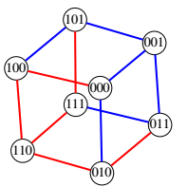
Case Study 2: Edge-antipodal colourings
Conjecture: For every dimension $d≥2$, in every edge-antipodal 2-edge-coloring of $Q_{d}$, there exists a monochromatic path between two antipodal vertices.
For $d=6$, search space of all colorings is: $2^{2^{\#edges/2}}=2^{2^{96}}$.

Slide 12
Case Study 2 Approach
For a pure SAT encoding, we need to ensure none of the antipodal vertices are connected by a path
32 connectivity constraints
UNSAT after 1.5 hours ($d=6$ holds)

Slide 13
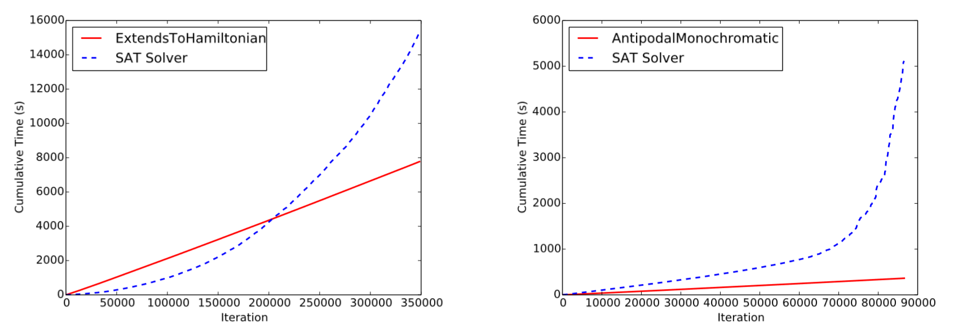
What’s the bottleneck?

Slide 14
Implementation Correctness
SAT solver resolution proofs
Use Drup-trim
SAGE computations
Interactions between them

Slide 15
Future Work and Conclusions
Moving to the SMT domain
Improved generation of proof objects / correctness checking
Exploiting symmetry breaking capabilities
Encoding complex predicates is facilitated by using off-the-shelf CAS algorithms
Promotes rapid extensibility/prototyping
Demonstrated two case studies on hypercubes
“Fun case studies”

Slide 16
Correctness
Sound, Complete, Terminating

Slide 17
Future Work
Moving to the SMT domain…
Z3 Tactics
Improved generation of proof objects / correctness checking.

Slide 18
Abstract DPLL(T)
Framework to reason about correctness of DPLL(T) systems (Nieuwenhuis, ‘05).
Our tool is most similar to the lazy-SMT approach (Section 3.1, Nieuwenhuis, ‘05):
SAGE constraints are abstracted as Booleans and checked later using SAGE.
No clause is generated infinitely many times.
Learned clauses from SAGE are never forgotten.
Additional checks:
Preprocessing steps.
No concrete theory T defined - must ensure decidability by defining requirements on graph predicates.

Slide 19
Graph Predicates
Theory T defined in terms of user-defined predicates.
Requirements:
Decidability of each predicate(?)
If a set of ground clauses are inconsistent with the predicates, the learned clauses preclude the same model from being generated again.

